Slide 1
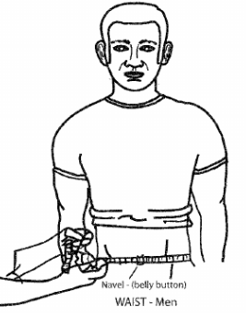
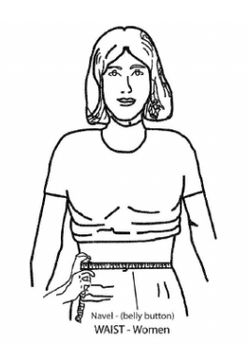
August 2023
Inspector General Update
Guidance on Changes to Army Directive 2023-11
(Army Body Fat Assessment for the Army Body Composition Program)
On 9 June 2023, Secretary of the Army released AD 2023-11, which implements modifications to the Army Body Fat computations.
Applicability: Regular Army, Army National Guard/Army National Guard of the United States, and U.S. Army Reserve.
Previous multi-site circumference method:
Calculated a male Soldier’s body fat percentage using neck and waist measurements.
Calculated a female Soldier’s body fat percentage using neck, waist, and hip measurements.
New one-site circumference tape method: only uses the waist (at the navel) to calculate body fat percentage for both male and female Soldiers.
Circumference tape method will be phased in over the next year. During this time, Soldiers who require circumference-based tape tests will take the one-site tape test. Those who fail are authorized to be measured by the previous multi-site circumference tape method for their confirmation tape test.
After 12 months from the date of AD 2023-11, the one-site tape test will be the only authorized circumference-based tape method.
Beginning 8 June 2024, one-site tape test method is the only authorized method.
Supplemental Body Fat Assessment:
Soldiers who fail the circumference-based tape methods will be flagged. However, at the time of their counseling for failure, they may request a supplemental body fat assessment, subject to the appropriate commander’s determination of reasonable availability. The flag is lifted if a Soldier passes the supplemental test.
Commanders will flag and refer all Soldiers who do not request/fail the supplemental body fat assessment to the ABCP.
Army Combat Fitness Test (ACFT) Exemption:
Per AD 2023-08, all Soldiers who score 540 or more on the record ACFT, with a minimum of 80 points in each event, are exempt from the Army body fat circumference-based tape assessment. This policy applies to Soldiers who complete all six primary events; no alternative events are authorized.
For more information, visit www.armyresilience.army.mil/abcp.
Pertinent Regulations/Policies:
AD 2023-11.
ALARACT 046/2023 (Notification of New Army Body Fat Assessment for the Army Body Composition Program).
AR 600-9 (The Army Body Composition Program).
AD 2023-08 (Army Body Fat Exemption for ACFT Score.
:
:
Contact the 1TSC IG: usarmy.knox.1-tsc.mbx.inspector-general@army.mil

